Slide 1
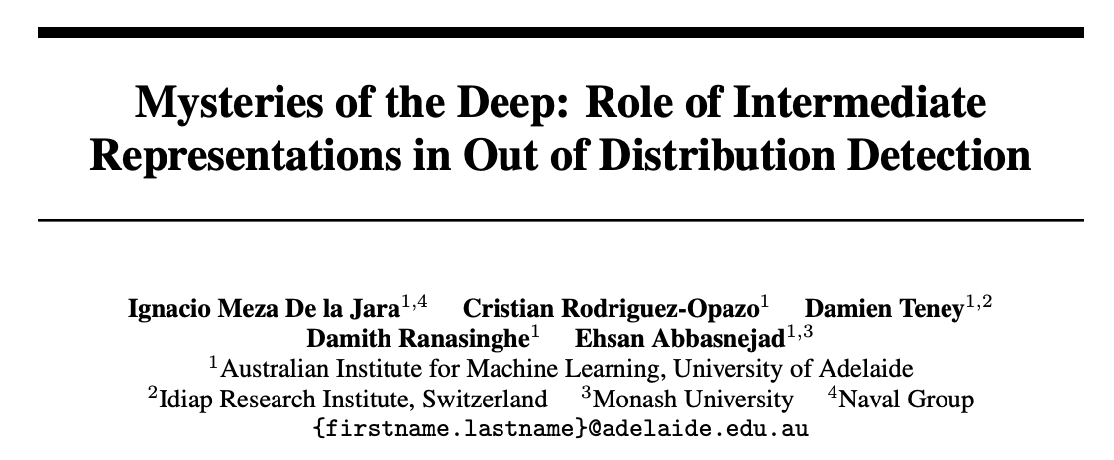
NeurIPS’2025
BioMedIA Reading Group
Francesco
22/01/2026

Slide 2
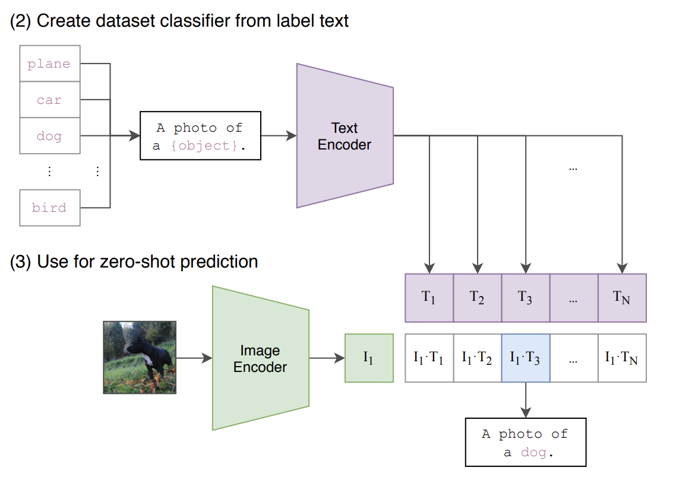
Zero Shot inference with CLIP
Radford, Alec, et al. "Learning transferable visual models from natural language supervision." ICML (2021)

Slide 3
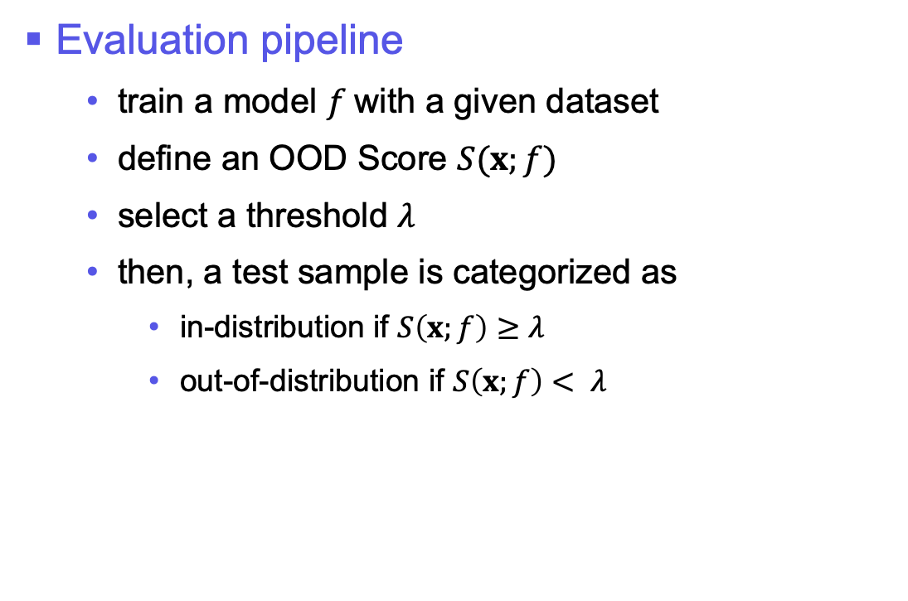
OOD Detection
Evaluation pipeline
train a model $f$with a given dataset
define an OOD Score $S(x;f)$
select a threshold $λ$
then, a test sample is categorized as
in-distribution if $S\left(x;f\right)≥λ$
out-of-distribution if $S\left(x;f\right)< λ$

Slide 4
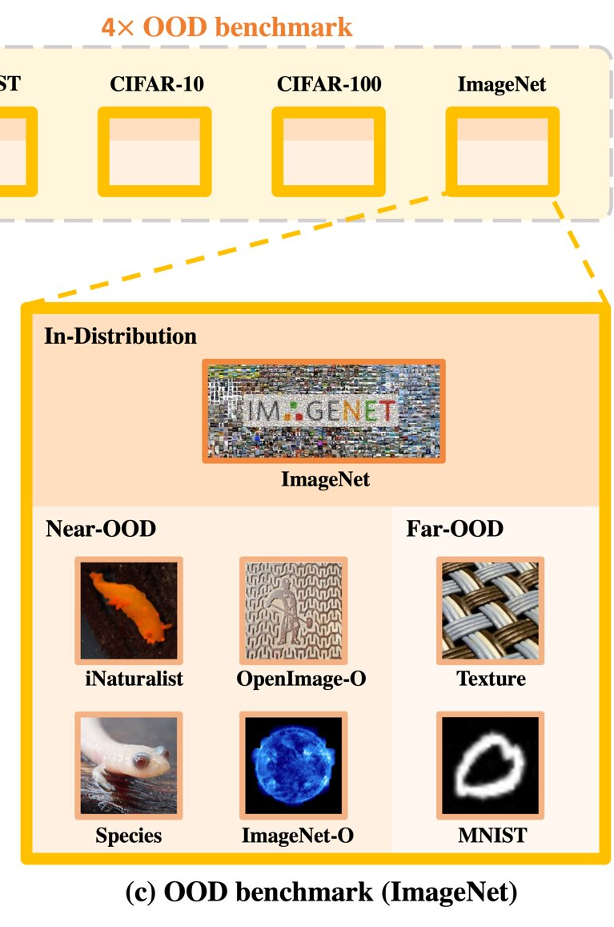
OOD Detection
Dataset categorization
Near-OOD
perceptually similar but semantically dissimilar to the training distribution.
Far-OOD
both perceptually and semantically dissimilar to the training distribution.
Yang, Jingkang, et al. "Openood: Benchmarking generalized out-of-distribution detection." NIPS (2022)

Slide 5
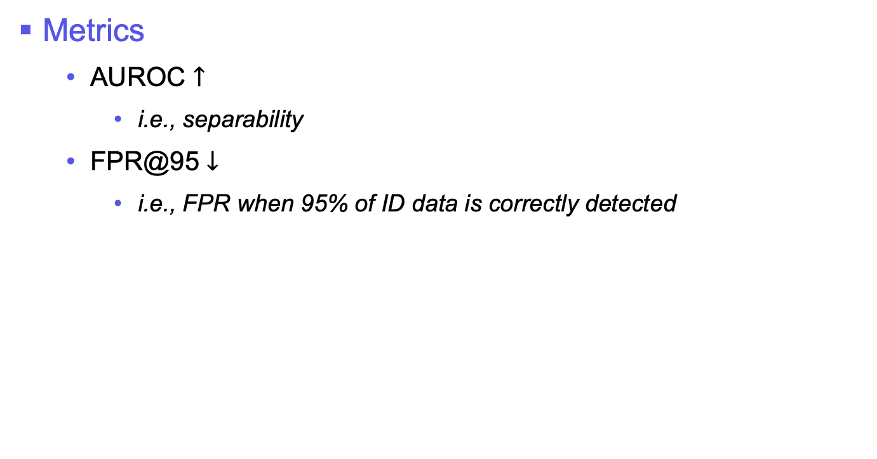
OOD Detection
Metrics
AUROC $↑$
i.e., separability
FPR@95 $↓$
i.e., FPR when 95% of ID data is correctly detected

Slide 6
Baseline: MCM
Maximum Concept Matching
highest similarity between image embedding and (known) text prompts
i.e., most-likely class according to training information

Slide 7
Common pitfall of OOD Detectors
They rely on the last-layer features
… failing to exploit the rich semantic embedded throughout the network

Slide 8
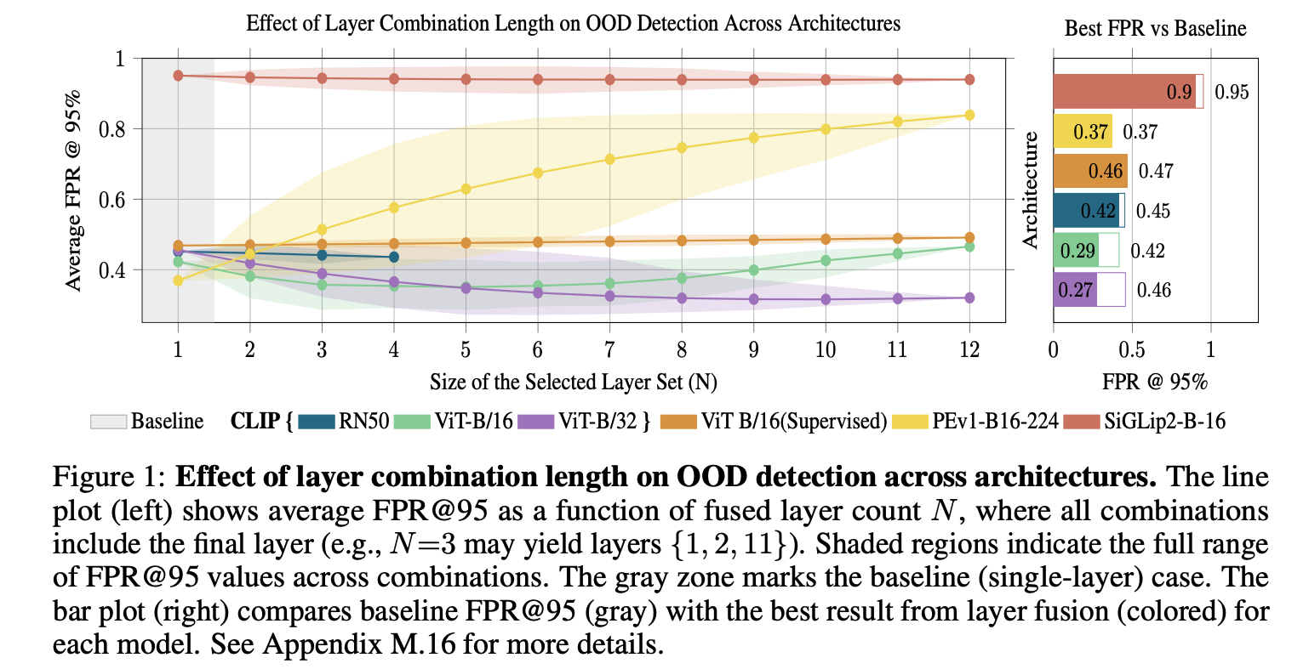
Layer combination
On CLIP, the largest set of layers exhibits the lowest FPR
On ViT (Sup), we do not notice improvement

Slide 9
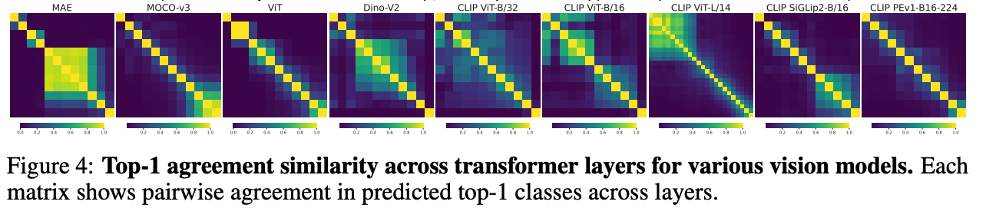
Layer agreements
CLIP-based models exhibit a broad area of agreement
ViT (Sup) exhibits a strong diagonal

Slide 10
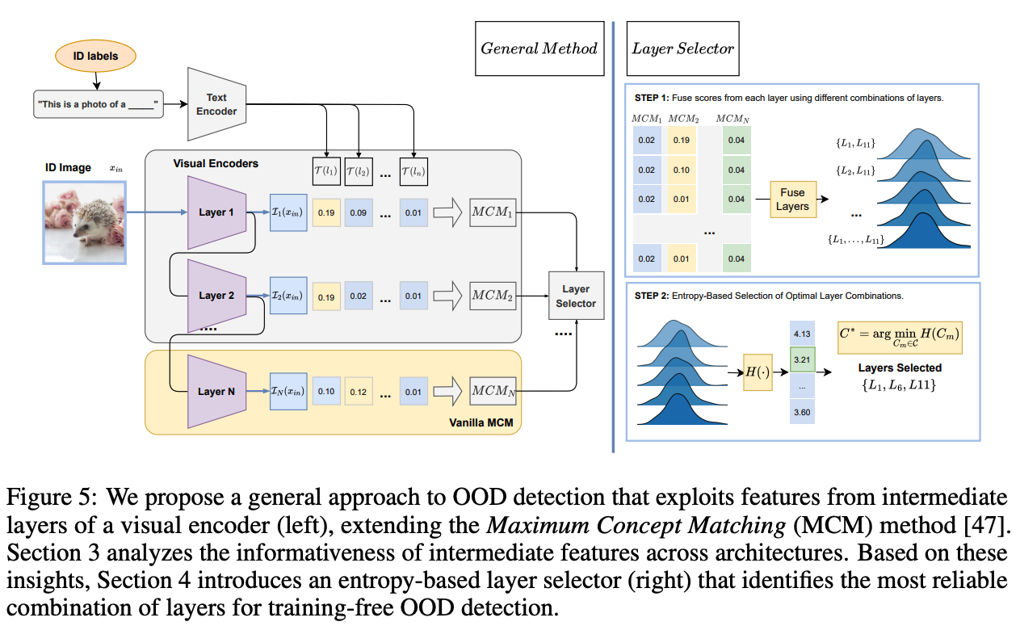
Method

Slide 11
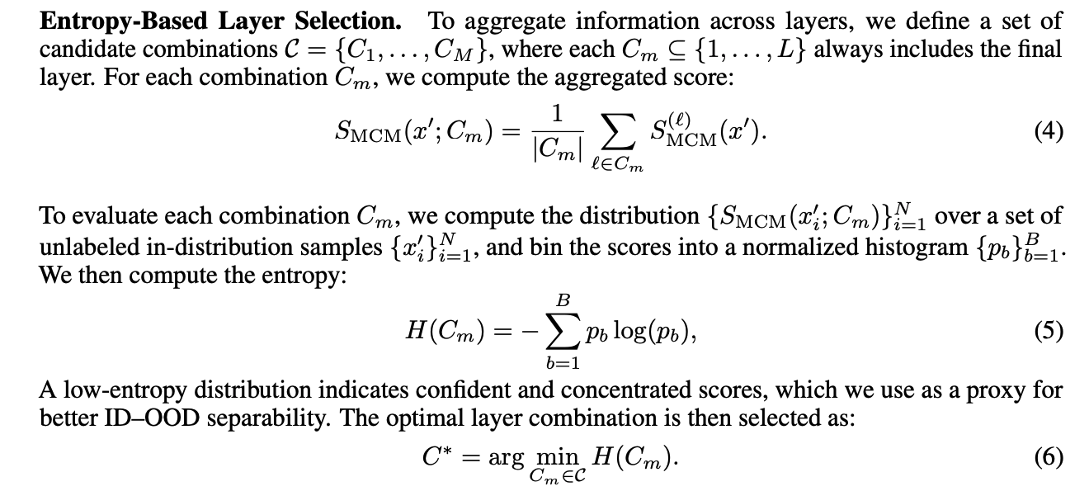
* The selection of the optimal layer combination takes approximately 50 seconds for both ImageNet-ID and Pascal-VOC
** Fusing 3 to 6 layers yields optimal results, capturing sufficient semantic diversity without introducing excessive redundancy

Slide 12
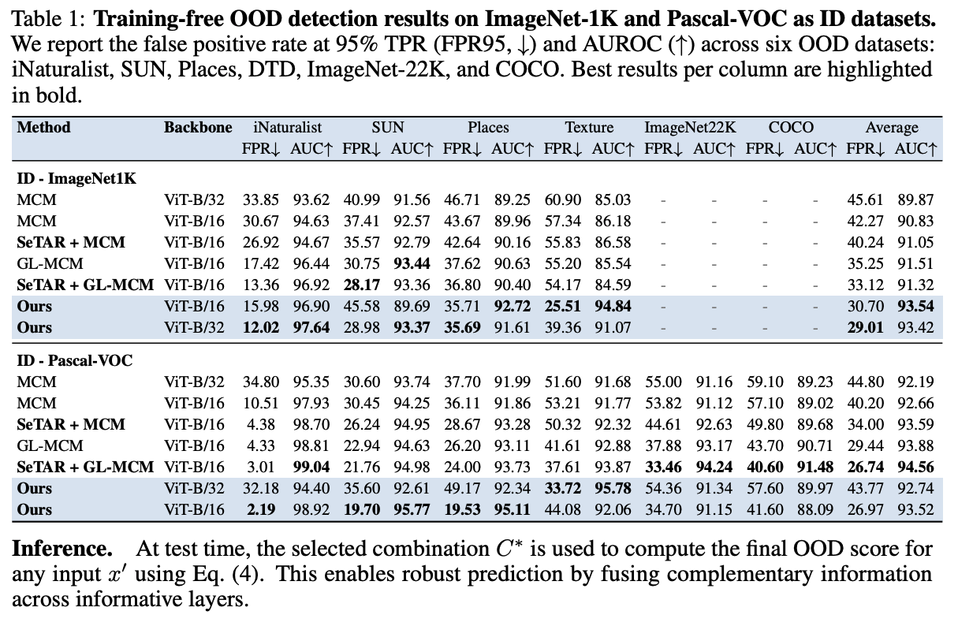
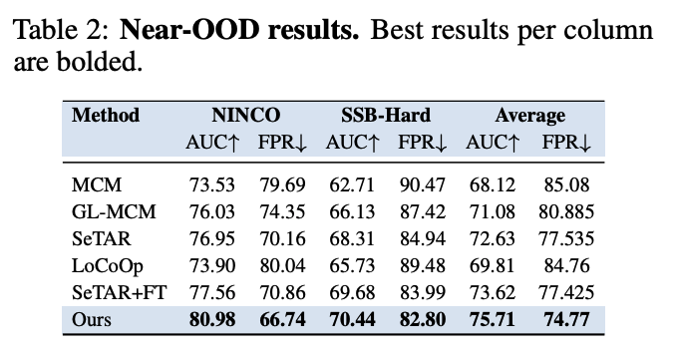

Slide 13
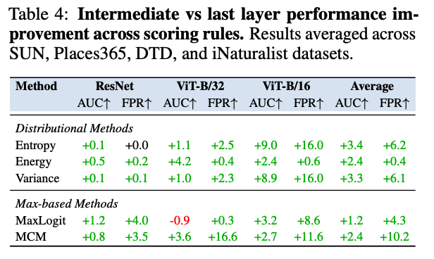
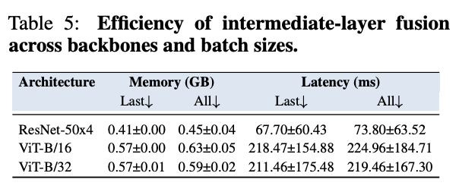
TL;DR: extracting intermediate
layers add modest overhead
TL;DR: the benefits are orthogonal
to the scoring sure

Slide 14
Discussion
Summary
the authors propose an effective OOD detector exploiting the rich semantic of ViTs
this is achieved via a training-free entropy based strategy
Limitations
they rely on encoders whose features are “diverse” throughout the networks
the optimal layer selection vary significantly across datasets (i.e., domain sensitivity)

Slide 15
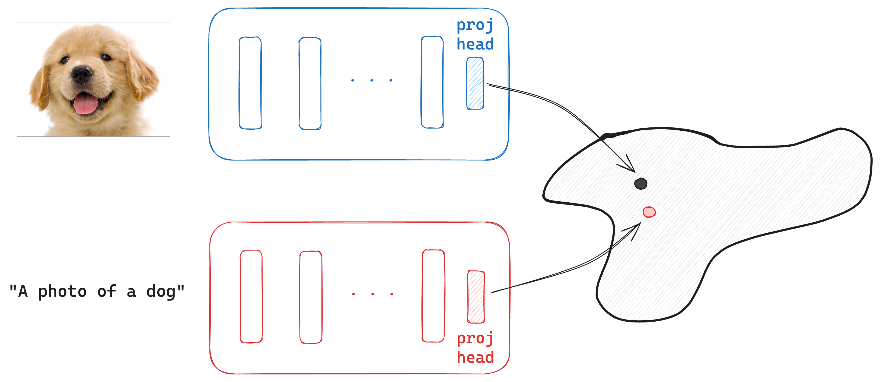
Future work?
How to use CLIP’s intermediate layers for classification?

Slide 16

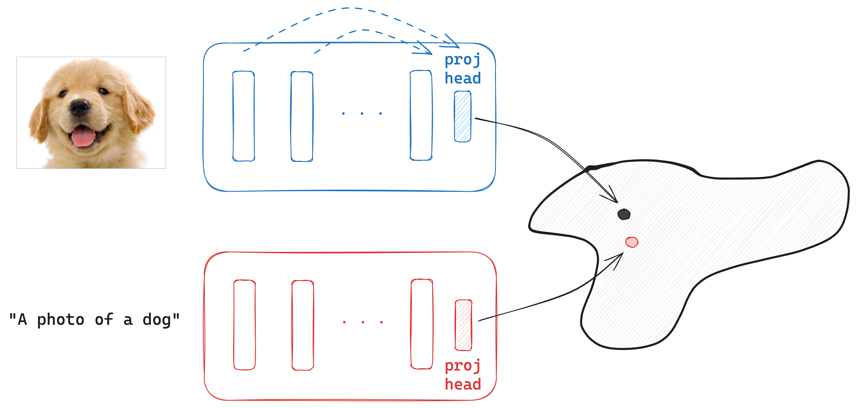
Future work?
this “works” for OOD detection
but not for classification!
How to use CLIP’s intermediate layers for classification?

Slide 17
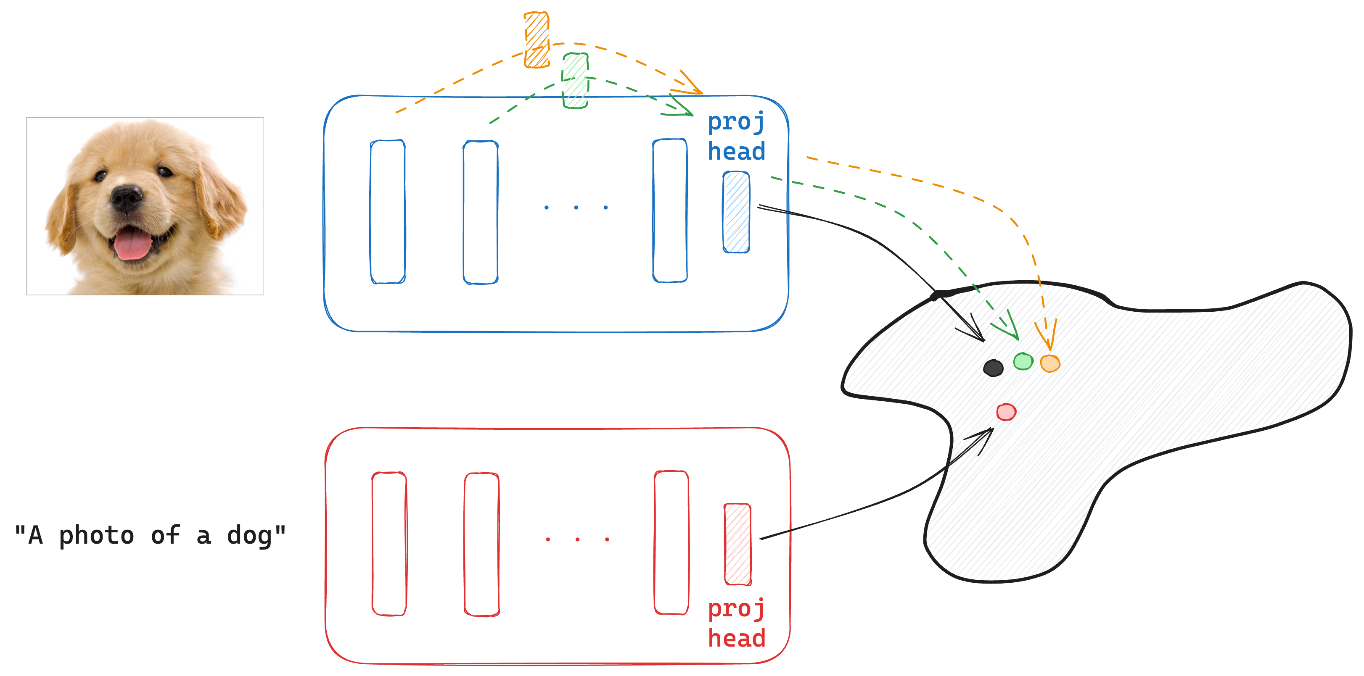
Future work?
How to use CLIP’s intermediate layers for classification?
1) Map early layers to the “latent” space of the last layer

Slide 18
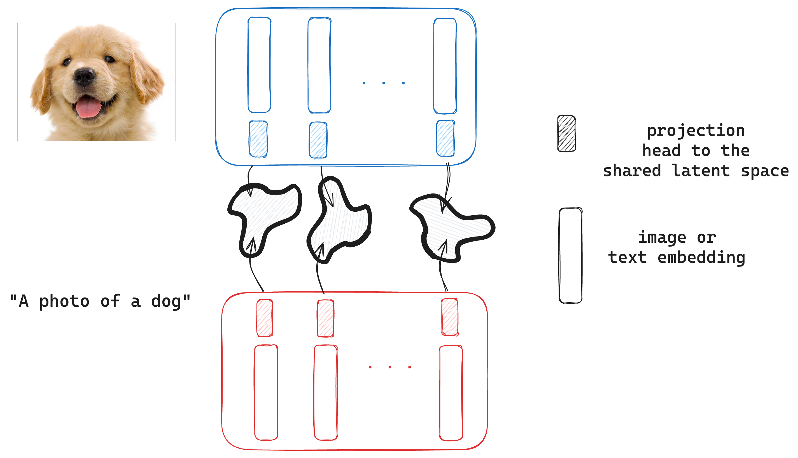
Future work?
How to use CLIP’s intermediate layers for classification?
2) Train novel shared latent spaces (and projection heads) for each layer [heavy!]

Slide 19
References
De la Jara, et al., “Mysteries of the Deep: Role of Intermediate Representations in Out of Distribution Detection,” NIPS (2025)
Radford, Alec, et al. "Learning transferable visual models from natural language supervision," ICML (2021)
Yang, Jingkang, et al. "Openood: Benchmarking generalized out-of-distribution detection." NIPS (2022)

Slide 20
Thank you!

Slide 21
Useful Shapes / Colors
example text
example text
example text
example text
example text
example text
Color Pallet Theme Colors
header
item...
→ implication ...

Slide 22

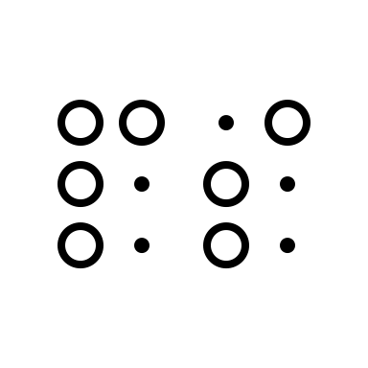
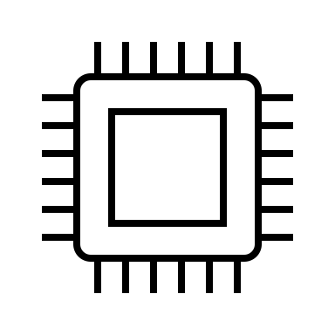






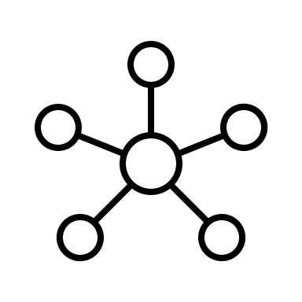


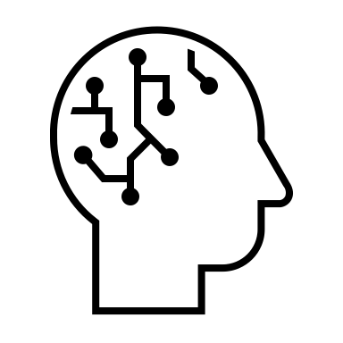



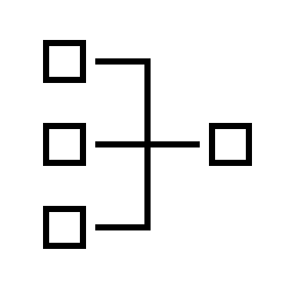






















Useful SVG Icons (colorable)
process
people
quotation marks
medical
feedback
arrows

